Slide 1
GROUP 4 – PVA HOT-HOUSE
The power of Data Analytics & Machine Learning

Slide 2
Agents’ journey from Rookie to PE Diamond
Group 4 - Increase PruElite conversion ratio & retention rate
Area of focus
Leads
Leads
Rookie
PE Gold
PE Platinum
PE Diamond
Leads matching
Potential PE
AI
AI
Find the set of PEs
Find their features BEFORE they became PEs
What are the events for a rookie to become PE
Filter current rookies having similar features
Filter on rookies who are 50% and above to be PE target

Slide 3
List of variables
Group 4 - Increase PruElite conversion ratio & retention rate
Variables | Weights
Which month did the agent activate | 0.32
Who is the first policy buyer | 0.21
NR_APE_Contribution in Group | 0.19
Agent_Age_Join | -0.19
Timing of 1st Policy | -0.14
Agent is Customer | 0.10
No. PE trained in last 12ms | 0.09
Group _Tenure | -0.06
Leader_Age | -0.05
%APE of PE Diamond/ # of PE Diamond in Group | -0.03

Slide 4
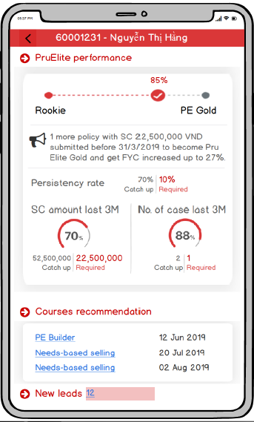
App demo
Group 4 - Increase PruElite conversion ratio & retention rate

